Slide 1
Problem solving with constructions
Constructions

Slide 2
how to use Oak lessons

Slide 3
I can use my knowledge of constructions to solve problems.

Slide 4
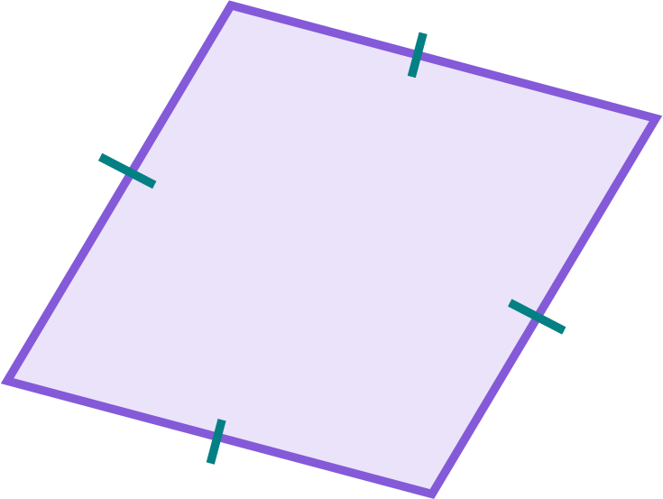
To bisect means to cut or divide an object into two equal parts.
A rhombus is a parallelogram where all sides are the same length.

Slide 5

Problem solving with constructions
Identifying polygons from premade constructions
Constructing shapes
Understanding properties of constructions

Slide 6
Identifying polygons from premade constructions
It is possible to identify different polygons and angles from a given set of constructions.
In this construction of a perpendicular bisector, there is:
a right angle
an equilateral triangle
60°
60°
A
B
a 60° angle
a rhombus
Which properties of this construction are important in defining these polygons and angles?

Slide 7
Identifying polygons from premade constructions
Both circles have the same radius as the length of AB.
This means that the distance from either endpoint to an intersection is equal in length to AB.
This creates an equilateral triangle or a rhombus, depending on how many points you join together.
10 cm
10 cm
10 cm
10 cm
A
B
10 cm
10 cm
10 cm
10 cm

Slide 8
Identifying polygons from premade constructions
Three congruent circles are drawn.
Two circles have centres at the endpoints of line segment AB, and the other has centre at the midpoint of AB.
8 cm
A
B
How many sides of this hexagon have length 8 cm?
All 6 sides have a length of 8 cm; this is a regular hexagon.
This is because the shape can be made from 6 equilateral triangles, each with a vertex at the centre of the middle circle.
Hint: these two line segments are radii of the centre circle, and create an equilateral triangle with the top side of the hexagon.

Slide 9
Identifying polygons from premade constructions
Two circles of different size have opposite endpoints of the line segment AB as their centres.
Which quadrilateral is created by joining the two endpoints of AB and the two intersections of the circles?
A
B
Kite

Slide 10


Identifying polygons from premade constructions
Which of these reasons explain why this quadrilateral is a kite?
a
The kite has two pairs of equal sides
A
B
b
The line segment through the two intersections passes through the midpoint of AB
c
Two of its sides are equal because they are both radii of the larger circle

Slide 11
Identifying polygons from premade constructions
1) Each copy of this construction shows congruent circles. The centre of the left and rightmost circles are the endpoints of line segment FG.
60°
F
G
F
G
a) Draw on and label:
a right angle
an equilateral triangle
a regular hexagon
b) Draw on and label:
a rectangle
a parallelogram

Slide 12
Identifying polygons from premade constructions
2) This construction shows three congruent circles.
The endpoints of line segment FG are centres of two of the circles, and lie on the circumference of the third.
One intersection of the above two circles is the centre of the third.
F
G
F
G
a) Draw and label two equilateral triangles of different sizes.
b) Draw and label two trapezia: one an isosceles trapezium, and one right-angle trapezium.

Slide 13
Identifying polygons from premade constructions
3) This construction shows two circles of different sizes.
The endpoints of line segment IJ are centres of the two circles.
I
J
I
J
a) Draw and label a kite, a perpendicular of IJ, and two isosceles triangles.
b) Draw and label two scalene triangles: one right angle and one non-right angle.

Slide 14
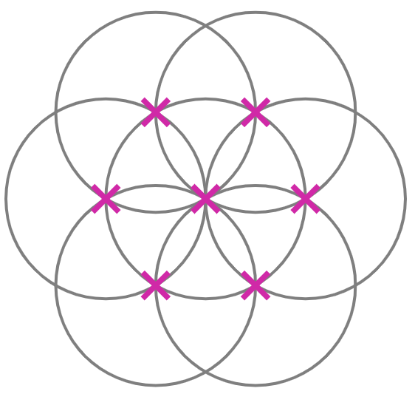
Identifying polygons from premade constructions
4) This construction shows seven congruent circles, each with their centres labelled with a cross.
a) Find, draw, and label as many different polygons and angles as you can find.
b) Suggest a type of quadrilateral that cannot be drawn accurately from this construction.
Explain how you know it can’t be drawn accurately.

Slide 15
Identifying polygons from premade constructions
1) Each copy of this construction shows congruent circles. The centre of the left and rightmost circles are the endpoints of line segment FG.
e.g.
e.g.
60°
F
G
F
G
a) Draw on and label:
a right angle
an equilateral triangle
a regular hexagon
b) Draw on and label:
a rectangle
a parallelogram

Slide 16
Identifying polygons from premade constructions
2) This construction shows three congruent circles.
The endpoints of line segment FG are centres of two of the circles, and lie on the circumference of the third.
One intersection of the above two circles is centre of the third.
e.g.
e.g.
F
G
F
G
a) Draw and label two equilateral triangles of different sizes.
b) Draw and label two trapezia: one an isosceles trapezium, and one a right-angle trapezium.

Slide 17
Identifying polygons from premade constructions
3) This construction shows two circles of different sizes.
The endpoints of line segment IJ are centres of two of the circles.
e.g.
I
J
I
J
a) Draw and label a kite, a bisector of IJ, and two isosceles triangles.
b) Draw and label two scalene triangles: one right angle and one non-right angle.

Slide 18
Identifying polygons from premade constructions
4) This construction shows seven congruent circles, each with their centres labelled with a cross.
e.g.
a) Find, draw, and label as many different polygons and angles as you can find.
Some examples of polygons include:
regular hexagon, irregular pentagon, trapezium, parallelogram, rhombus, arrowhead, equilateral triangle.
Some examples of angles include:
60°, 90°, 120°, 240°

Slide 19
Identifying polygons from premade constructions
4) This construction shows seven congruent circles, each with their centres labelled with a cross.
b) Suggest a type of quadrilateral that cannot be drawn accurately from this construction.
Explain how you know it can’t be drawn accurately.
A square cannot be drawn accurately.
This is because all lengths that are of equal size are at an angle of either 30° or 60° to each other.

Slide 20
Problem solving with constructions
Identifying polygons from premade constructions
Constructing shapes
Understanding properties of constructions

Slide 21
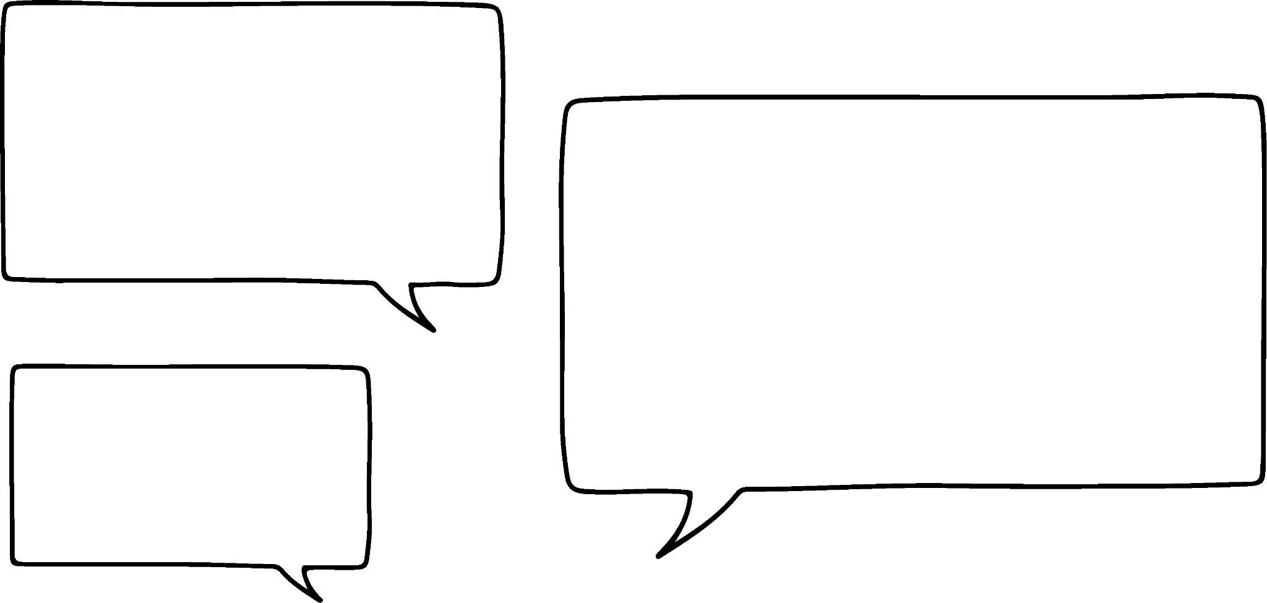


Constructing shapes
We can create such awesome shapes using these constructions!
Yeah, but wouldn’t it be more satisfying to create the shapes by constructing them from scratch?
Laura
Sofia

Slide 22
Constructing shapes
I will show the construction of this diagram on the left, with the instructions on the right.
After each set of steps, perform the same steps yourself.

Slide 23
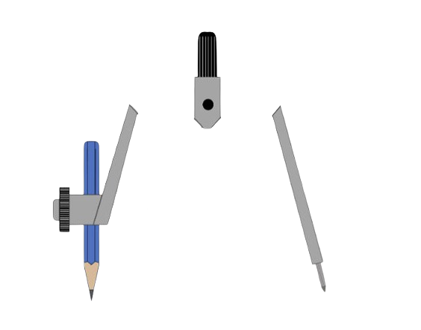
Constructing shapes
Point A is the centre of the left circle, whilst point B is the centre of the right circle.
The circle with centre A will be the central circle in this diagram.
In the centre of your page, draw a line of 4 cm and label it AB.
This will be the radius of each of the seven congruent circles.
With the compass needle on A, set your compass to the length of AB and draw a circle.
A
B
With the compass needle on B, draw another circle of equal size.
Try it yourself.

Slide 24
Constructing shapes
Label one of the intersections of your two circles point C.
Place your pair of compasses on point C and construct another circle.
A
B
C
Try it yourself.

Slide 25
Constructing shapes
Place your compass needle on the point where your most recently drawn circle intersects the circle with centre A (the blue, dashed circle).
Label it the next letter.
Draw another circle.
A
B
Try it yourself.
D
C
Repeat the steps on this slide three more times to complete the construction.

Slide 26
Constructing shapes
This is the completed construction called the six-petal flower construction.
F
G
You can change the length of the initial line segment (AB in this diagram) to change the length of the sides of the polygons you can create from the construction.
E
A
B
D
C

Slide 27
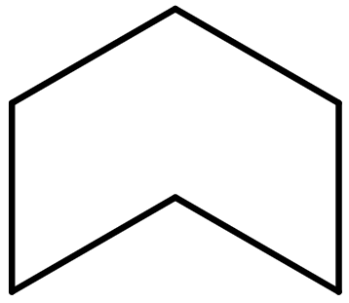
Constructing shapes
1) By constructing either part of or all of a six-petal flower, accurately construct the following shapes.
120°
a)
b)
c)
d)
240°
4 cm
60°
120°
5 cm
60°

Slide 28
Constructing shapes
2) Many logos of real-world, famous companies are created using arcs and sectors of circles made from constructions.
By first using a six-petal flower template to help you plan, construct from scratch your own logo.

Slide 29
Constructing shapes
1) By constructing either part of or all of a six-petal flower, accurately construct the following shapes.
e.g.
a)
e.g.
b)
120°
60°
Initial line segment of 4 cm
Initial line segment of 5 cm
Initial line segment of 2 cm

Slide 30
Constructing shapes
1) By constructing either part of or all of a six-petal flower, accurately construct the following shapes.
e.g.
c)
e.g.
d)
240°
120°
60°

Slide 31
Constructing shapes
2) Many logos of real-world, famous companies are created using arcs and sectors of circles made from constructions.
By first using a six-petal flower template to help you plan, construct from scratch your own logo.
There are many possible logos that could be created.

Slide 32
Problem solving with constructions
Identifying polygons from premade constructions
Constructing shapes
Understanding properties of constructions

Slide 33
Understanding properties of constructions
A perpendicular bisector can be constructed in many different ways.
B
A
This perpendicular bisector involves a line passing through the intersection of two congruent circles.

Slide 34
Understanding properties of constructions
A perpendicular bisector can be constructed in many different ways.
But what if there were multiple pairs of congruent circles?
In this diagram, there are four intersections of pairs of circles that are congruent.
Drawing a line through any two of these intersections will construct the perpendicular bisector of AB.
B
A
A perpendicular bisector can be drawn from these two intersections, even if the rest of the circle cannot be constructed.

Slide 35

Understanding properties of constructions
Alex says he has constructed a perpendicular bisector because his line passes through two intersections between pairs of circles.
Alex
Which of these statements explain why Alex’s construction is incorrect.
a
All the circles should be the same size.
B
A
b
Some of the circles have a radius bigger than AB.
c
The intersections should be between pairs of circles of equal size.

Slide 36
Understanding properties of constructions
An angle bisector can be constructed in many different ways.
This angle bisector involves constructing a rhombus from three congruent circles.
One of the diagonals of the rhombus bisects the angle.
A

Slide 37
Understanding properties of constructions
An angle bisector can be constructed in many different ways.
This angle bisector involves constructing a kite with only two circles, each of different size but with the same centre.
Two line segments are drawn. Each line segment joins:
A
an intersection between the smaller
circle and a leg
an intersection between the larger
circle and the other leg

Slide 38
Understanding properties of constructions
An angle bisector can be constructed in many different ways.
The fourth point of the kite is the intersection of these two line segments.
The diagonal that bisects the kite also bisects the angle.
A

Slide 39
Understanding properties of constructions
Which two pairs of points need to be joined with a line segment to find the fourth point in the kite?
D
C
BF and CG
B
G
F
A
E

Slide 40
Understanding properties of constructions
1) Accurately construct the perpendicular bisector to XY without any of your construction arcs and circles going outside the box.
2) Accurately construct the angle bisector to this 290° angle using the circle given and measure the size of the bisected angle.
Y
X

Slide 41

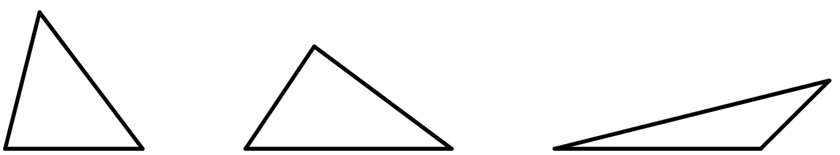
Understanding properties of constructions
3) The area of a triangle can be found using the formula
area =
× base × perpendicular height
By performing the appropriate construction, accurately measure the perpendicular height of each triangle to find its area.
c)
b)
a)
base
base
base

Slide 42
Understanding properties of constructions
1) Accurately construct the perpendicular bisector to XY without any of your construction arcs and circles going outside the box.
2) Accurately construct the angle bisector to this 290° angle using the circle given and measure the size of the bisected angle.
145°
Y
X

Slide 43
Understanding properties of constructions
3) The area of a triangle can be found using the formula
c)
b)
a)
base
base
base
The perpendicular height of b) is half of its base.
The perpendicular height of c) is a third of its base.
The perpendicular height of a) is equal to its base.
The area of each triangle will depend on the scale with which the triangles have been printed.

Slide 44
Problem solving with constructions
Equilateral triangles, rhombi, parallelograms, trapezia (and more), each with angles of 60° and 120° can be identified and constructed from congruent circles.
Kites can be constructed from two non-congruent circles.
The perpendicular to a line segment through a point off of the line segment is the shortest distance from the point to the line segment. This can be shown by constructing a circle, with the centre at this point, which intersects the line segment once.
There are multiple ways to bisect an angle and perpendicularly bisect a line segment.

Slide 45

© Oak National Academy 2023.
Produced in partnership with Mathematics in Education and Industry.
Licensed on the Open Government Licence v3.0, except where otherwise stated. See Oak terms and conditions.

